Slide 1
CHAPTER 2
POLAR COORDINATES

Slide 2
CONTENTS
2.1. Polar Coordinate System
2.2. Areas & Lengths in Polar Coordinates
2.3. Conic Sections in Polar Coordinates

Slide 3
2.3. CONIC SECTIONS IN POLAR COORDINATES
2.3.1. Conic Sections
2.3.2. Conic Sections in Polar Coordinates
2.3.3. Kepler’s Law

Slide 4
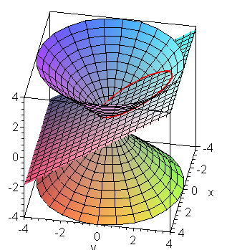
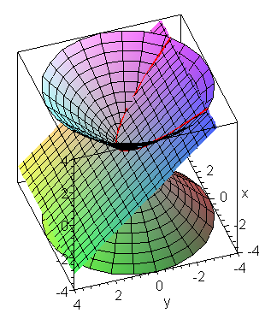
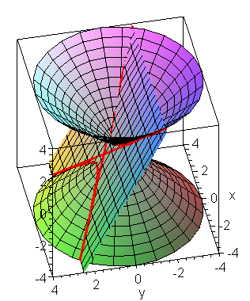
2.1. Conic Sections
Recall that a conic section is the intersection of a plane and a cone
The conic section can be
an ellipse
a parabola
a hyperbola

Slide 5
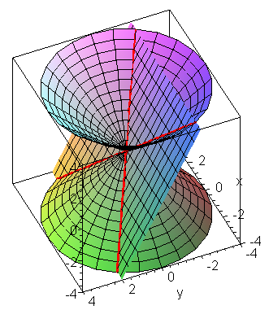
Note that the intersection can be two lines or a single point if the plane passed through the vertex of the cone
OY
Let z² = k²(x² + y²) be the equation of the cone C, and z = tanα y + d be the equation of the plane P
OX
In P we choose a cartesian coordinate system consisting of the axe OX parallel to Ox
and the intersection OY of P and the vertical plane Oyz
Then the intersection of C and P satisfies
Completing the square, we can put it in the standard form

Slide 6
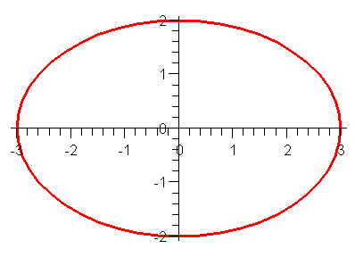
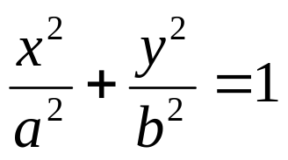
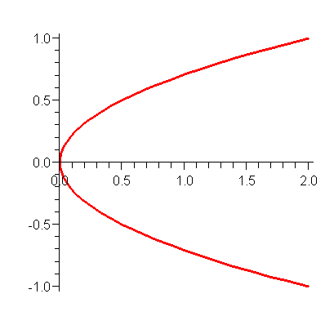
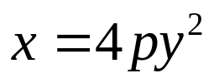
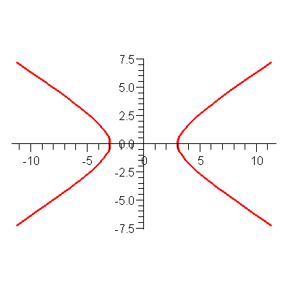
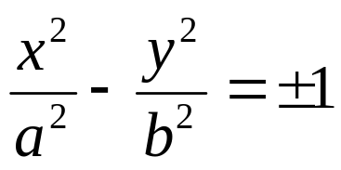
The standard equations of conic sections are:
(a) for an ellipse
(b) for a parabola
(c) for a hyperbola

Slide 7
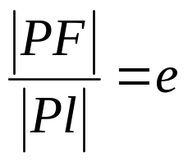
2.3.2. Polar Equation of Conic Sections
Theorem. Let F be a fixed point (called the focus) and l be a fixed line (called the directrix). Let e be a fixed positive number (called the excentricity).
The set of all points P in the plan such that
is a conic section. The conic section is
(a) an ellipse if e < 1
(b) a parabola if e = 1
(c) a hyperbola if e > 1

Slide 8
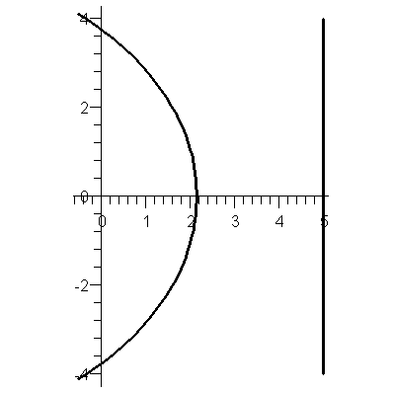
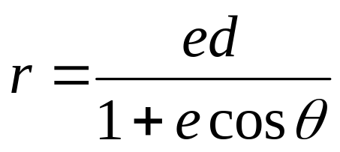
Proof. Let P be a point on the conic section C with polar coordinates (r, θ )
Let x = d be the directrix.
Then Pl = d – r cosθ.
Hence r = e(d – r cosθ)
Therefore the polar equation of the conic section is
P
l
r
We have
x ²+ y² = r² = e²(d – x)²
= e²(d² – 2dx + x²)
(1 – e²) x² + 2de²x +y² = e²d²
θ
F
(-r,θ )
d

Slide 9
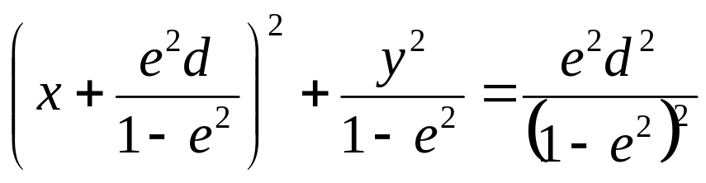
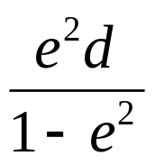
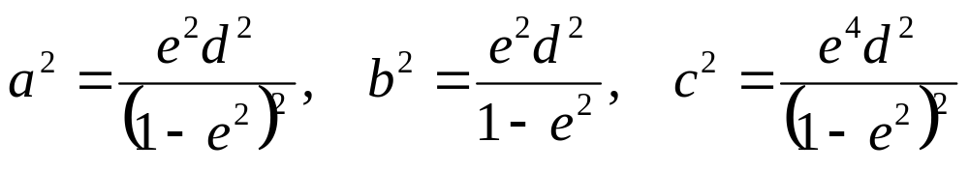
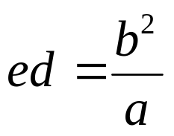
(1 – e²) x² + 2de²x +y² = e²d²
(*)
If e < 1, then the above is the equation of an ellipse in cartesian coordinates, shifted to the left by an amount
P
l
Note that
r
θ
F
d

Slide 10
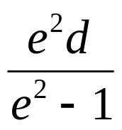
(1 – e²) x² + 2de²x +y² = e²d²
(*)
On the other hand if e > 1, then (*) is the equation of a hyperbola in cartesian coordinates, shifted to the right by an amount
P
l
r
θ
Finally if e = 1, then we get a parabola with equation y² = 4p(p – x)
where p = d/2
F
d

Slide 11
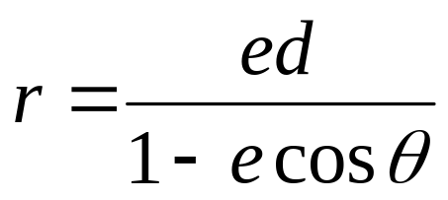
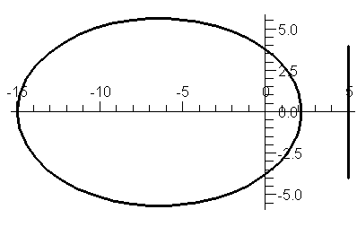
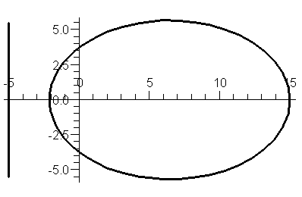
Note. If the directrix has the equation x = –d, then the polar equation of the conic section is

Slide 12
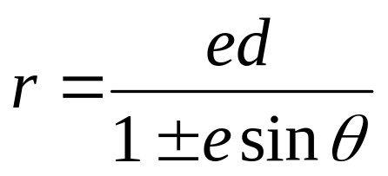
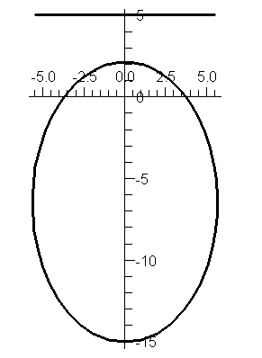
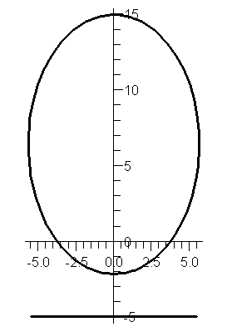
Similarly if the directrix has the equation y = ±d, then the polar equation of the conic section is

Slide 13
1.8.3. Kepler’s Law
Kepler’s Law.
A planet revolves around the sun in an elliptical orbit with sun as one focus.
The ray from the sun to the planet sweeps out equal area in equal times.
The square of the period of revolution T of a planet is proportional to the cube of the major axis a of its orbit

Slide 14
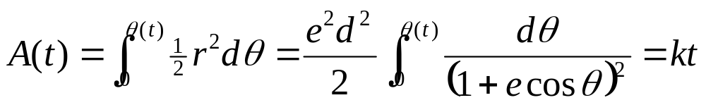
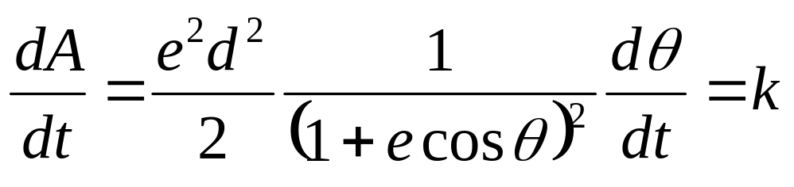
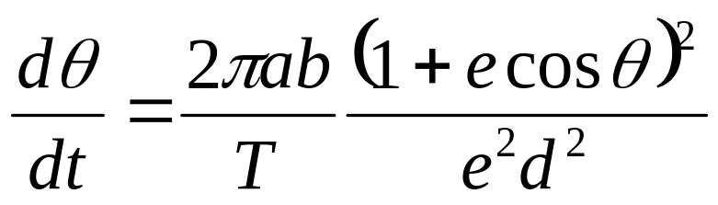
We have by Kepler’s second law
Differentiate both sides:
The constant k is determined by π ab = k T so that

Slide 15
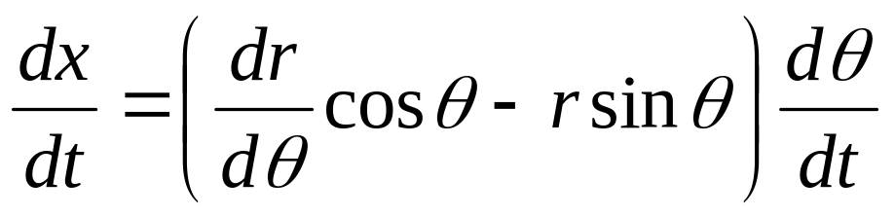
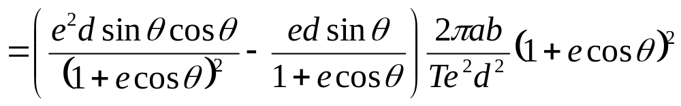
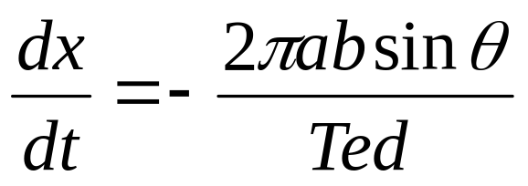
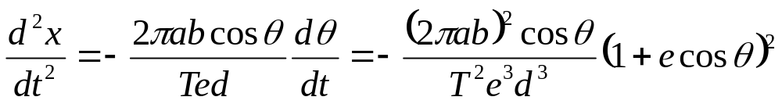

Slide 16
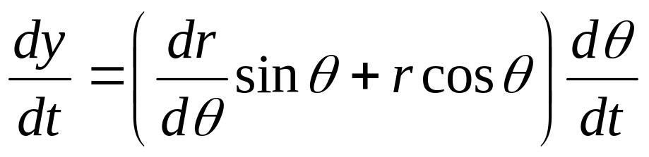
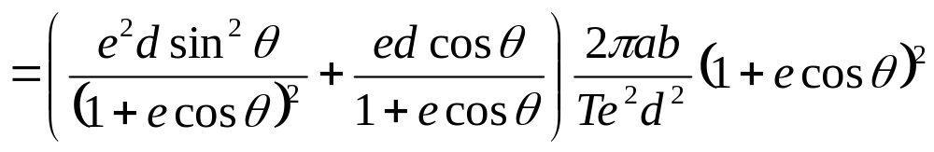
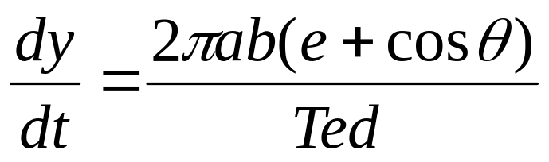


Slide 17
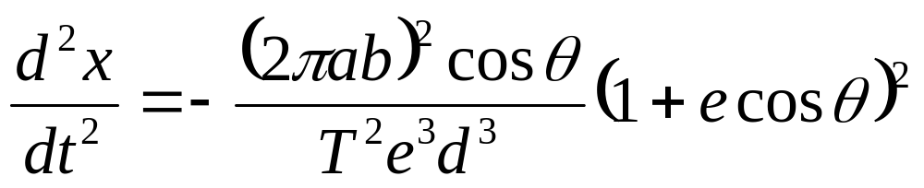
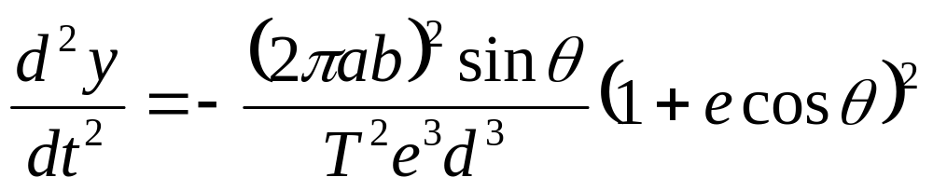
Now the vector v with components dx/dt and dy/dt is the velocity vector
and the vector a with components d²x/dt² and d²y/dt² is the acceleration vector of the planet.
The above formulae show that the acceleration vector a is parallel to the position vector s with components r cos θ and r sin θ.
Therefore the Newton’s force F = ma acting on the planet is directed toward the sun

Slide 18

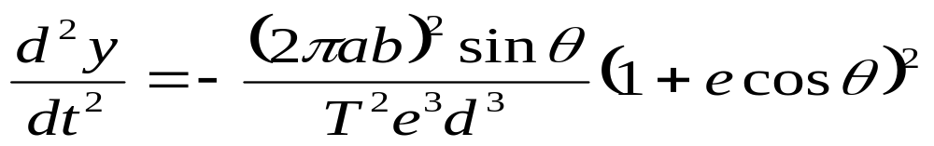
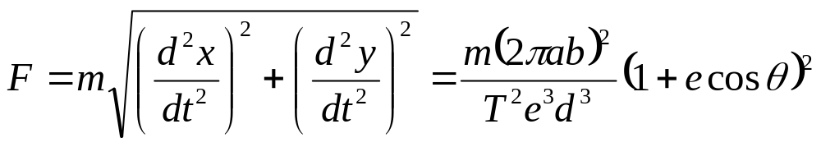
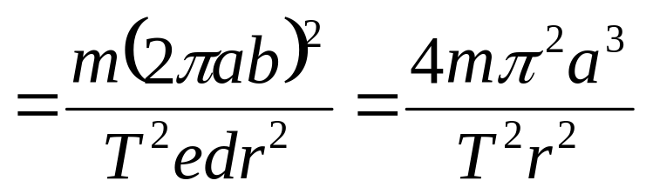
The magnitude of the force is
Now the constant a³ / T² doesn’t depend on the planet by Kepler’s third Law

Slide 19
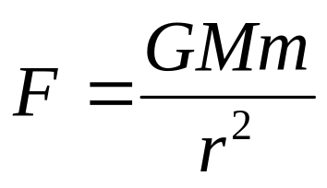
The attraction force by the sun on any planet is placed on the line joining the sun and the planet
and directed toward the sun.
It’s magnitude has the form
P
S
where M and m are the masses of the sun and the planet
and G is a universal constant that does not depend on the planet

